Slide 1
Data Analysis
Data Analysis means understanding, cleaning, analyzing, and extracting insights from data to make better decisions.
Basic Steps:
Collect Data – Gather data from different sources.
Clean Data – Remove errors, fix missing values, and standardize it.
Find Patterns & Trends – Use graphs, charts, and statistics to understand the data.
Make Decisions – Use insights to improve business strategies or processes.
In simple words, turning raw data into useful information is data analysis!

Slide 2
About Dataset
Brazilian E-Commerce Public Dataset by Olist :-
This is a Brazilian ecommerce public dataset of orders made at Olist Store. The dataset has information of 100k orders from 2016 to 2018 made at multiple marketplaces in Brazil. Its features allows viewing an order from multiple dimensions: from order status, price, payment and freight performance to customer location, product attributes and finally reviews written by customers. We also released a geolocation dataset that relates Brazilian zip codes to lat/lng coordinates.
This is real commercial data, it has been anonymised, and references to the companies and partners in the review text have been replaced with the names of Game of Thrones great houses.

Slide 3
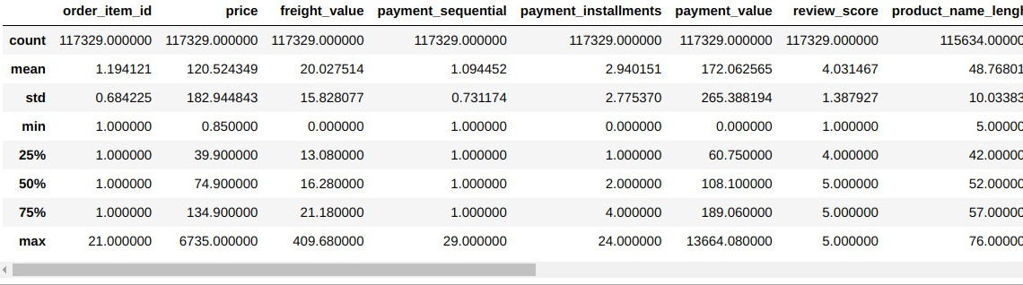
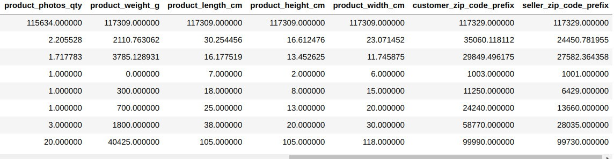
Statistical Description of Data

Slide 4
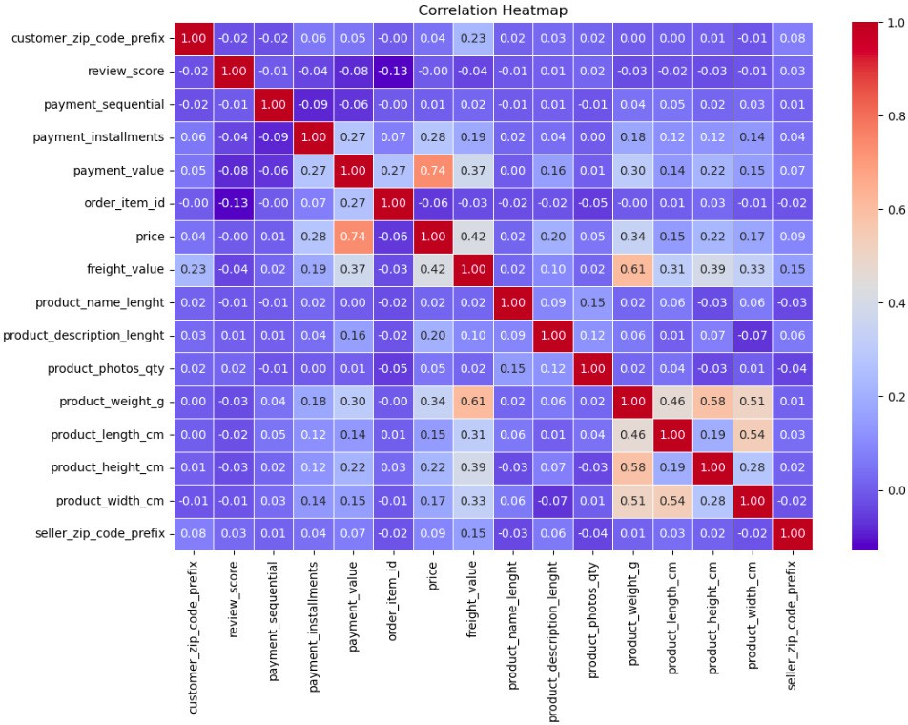

Slide 5
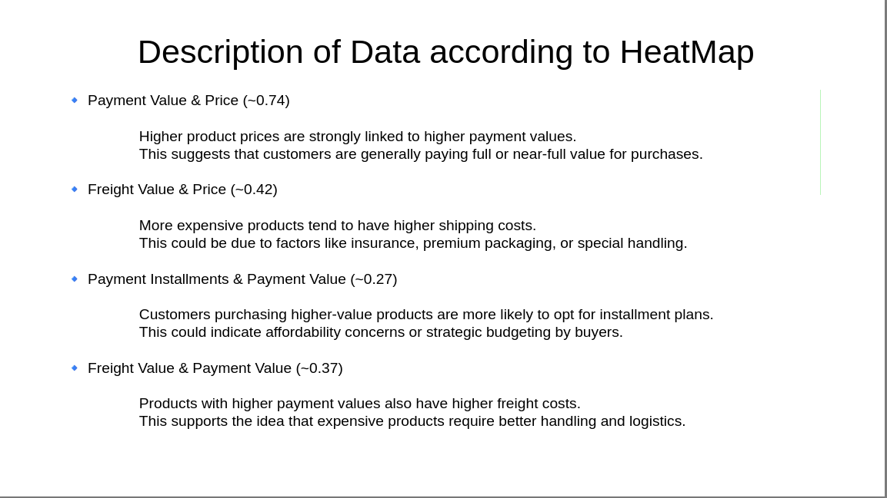

Slide 6
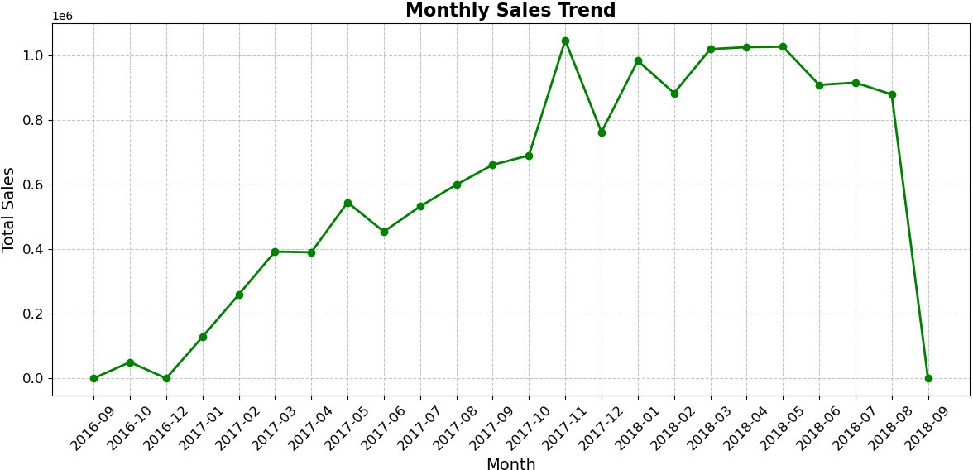
Monthly Trends
It has been observed that highest sale was seen in the November 2017 and their was extreme downfall in the sales of September 2018.

Slide 7
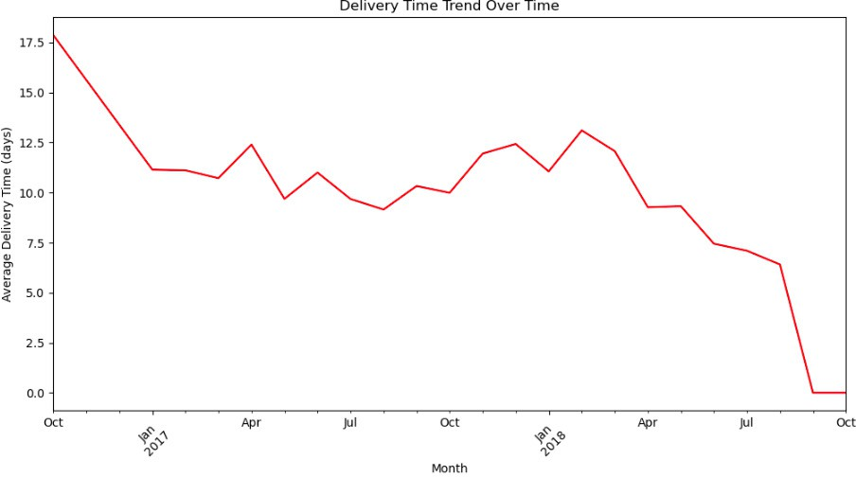
Analyzing delivery performance over time
We can see that there is an sudden decrement in delivery time after Jan 2017 and by Oct 2018 it reached to its lowest.

Slide 8
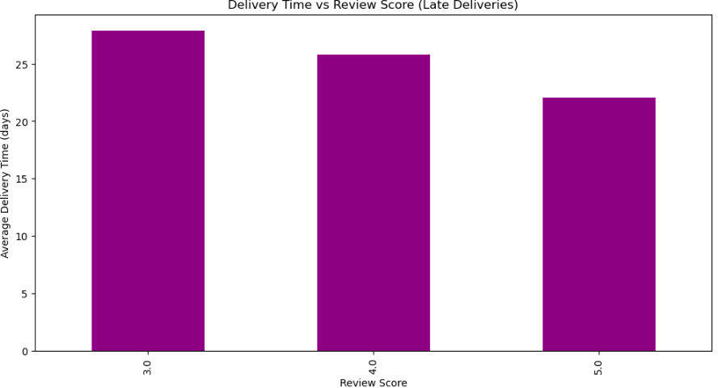
Relationship between deliveries and reviews
It can be observed that as the delivery days is increasing there is decrement in review rate.

Slide 9
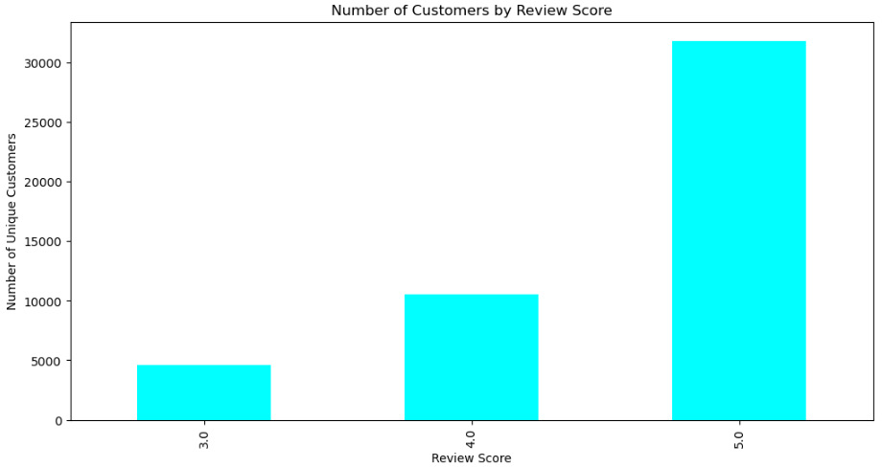
Segmentation Based on Review Scores
As noticed that 30000+ customers rated 5 to the product which shows the success of product.

Slide 10
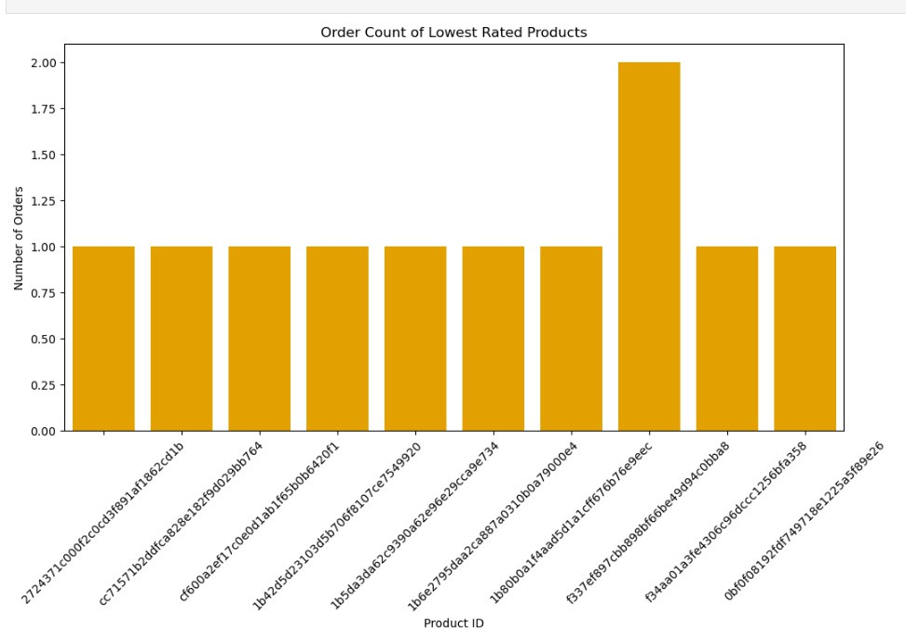
The products that were least rated

Slide 11
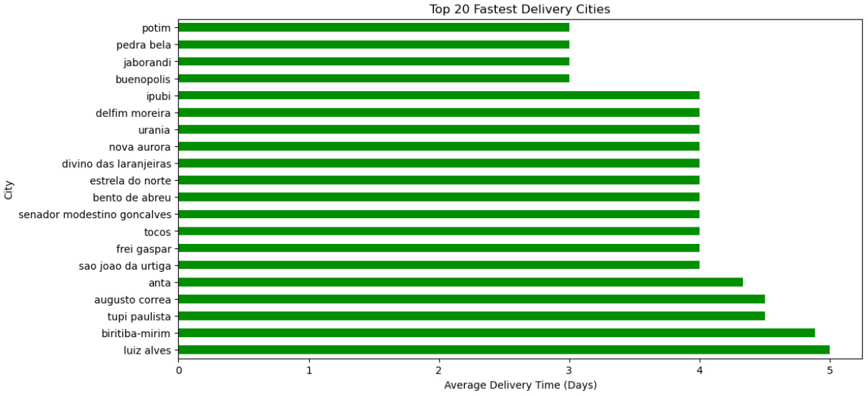
Time taken to deliver in each city
Potim, Pedra Bela and Jaborandi these cities experienced the smallest delivery time of approx 3 days.

Slide 12
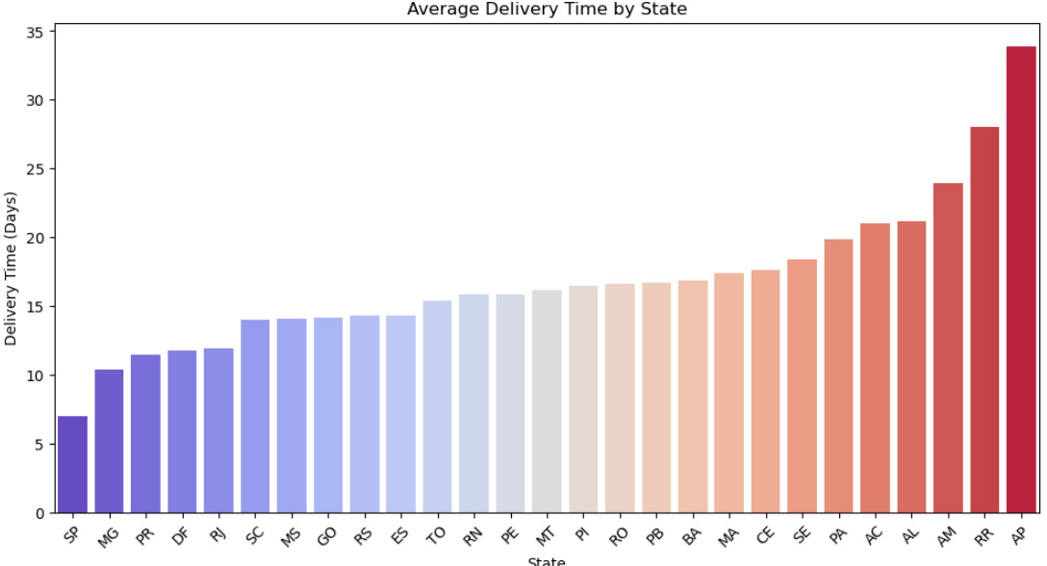
States with increasing order of delivery time
Minimum of 7 days and maximum of 33 days were taken to deliver across each state .

Slide 13
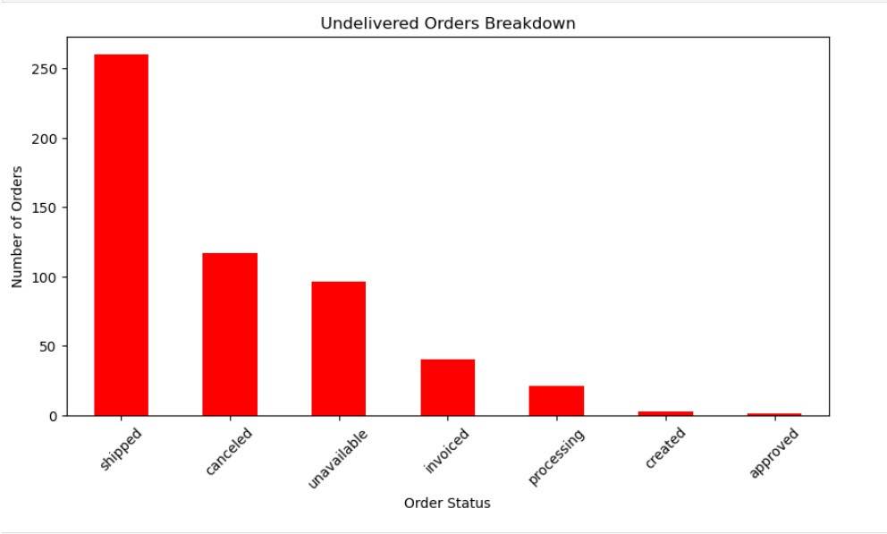
Order Status
It can be observed that approx 250 orders were shipped and approx 120 orders were cancelled.

Slide 14
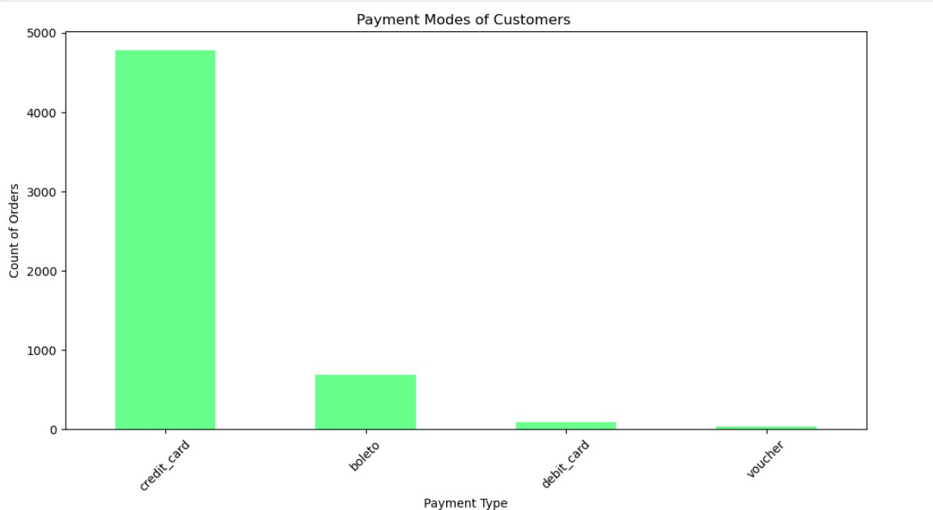
Modes of the payment
The customers usually pay using credit card as this mode of payment offers maximum discount.

Slide 15
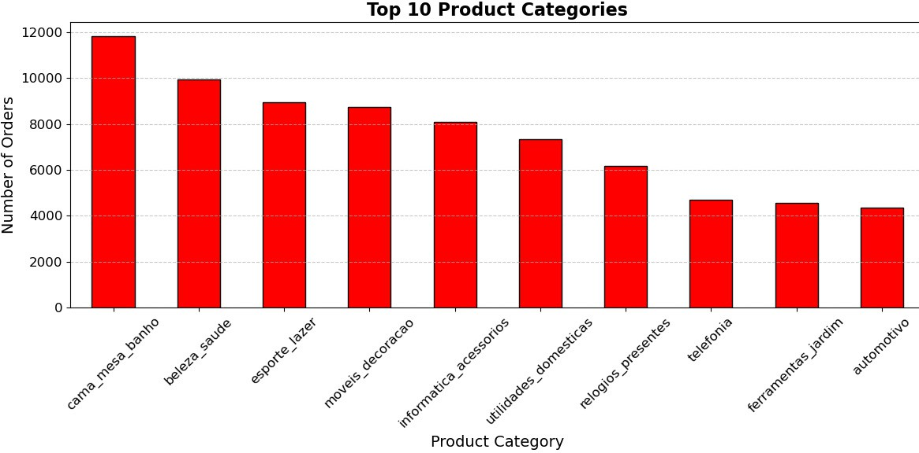
Top 10 products with highest sale
It has been observed that the highest sale 12000 was seen by the product "Cama_Mesa_Banho".

Slide 16
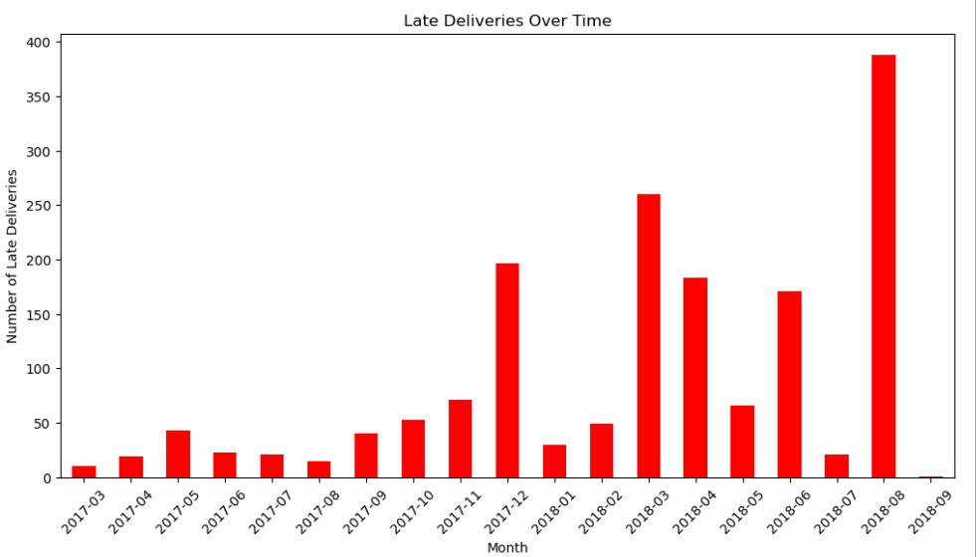
Number of Late Deliveries done in each month
It has been observed that highest late delivery reached the peak of 400 in month of August, 2018

